Slide 1

Access Control
Group 3
Karmdeep Kaur
Dwity Gohil
Ripunjoy Madhab buddha

Slide 2
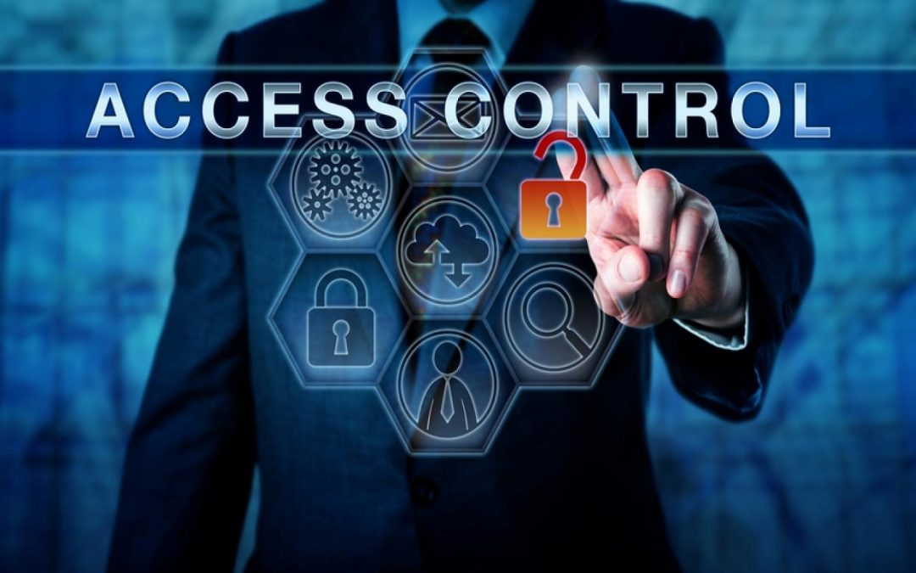
what is access control?
Access control systems deliver basic security features that regulate user permissions. They make use of technologies such as passwords, biometrics, and security certificates, among others. This is considered one of the most important processes in your organization that help minimize the risks of identity theft and fraud, credential theft, and ransomware attacks.

Slide 3
Access control based on The Three (3) A’s (and One I) of Access Control
Access control systems are a fundamental part of any organization’s identity-proofing. Depending on the software or tool, the process is triggered when a person attempts to identify themselves in the system.
To better understand access control, we can take a deeper look into the four basic elements—identification, authentication, authorization, and accountability—and how they make the framework of this fundamental security feature.

Slide 4
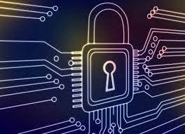
Identification – Identification is the starting point, where the users provide information about their identity. Today’s systems use authentication factors like fingerprint, retinal, or facial scans, which can be used to validate them in the system.

Slide 5
How Is Identity Verified?
A secure identity should be distinct in the sense that it should be possible for two users to identify themselves clearly. In the context of account monitoring, this is very significant. If the authentication systems are disconnected, it is feasible for identities to be duplicated.
The list that follows highlights the key concepts of identity.
Identities should be unique. Two users with the same identity should not be allowed.
2. Identities should be nondescriptive. It should not be possible to infer the role or function of the user. For example, a user called “Admin” represents a descriptive identity, whereas a user called “o1337ms1” represents a nondescriptive identity.
3. Identities should be securely issued. A secure process for issuing an identity to a user needs to be established.
4. Identities can be location-based. A process for authenticating someone based on his or her location.

Slide 6
Authentication – Authentication focuses on users providing proof of identity before being granted access to the system. Verification, which ideally is a multi-factor authentication process, proves that they are whom they claim to be. Entering a password, using a digital or physical key, and providing a biometric measure for accuracy are some of the ways to do this effectively.
The disadvantage of using this method is that once the information is lost or stolen (for example, if a user’s password is stolen), an attacker would be able to successfully authenticate.

Slide 7
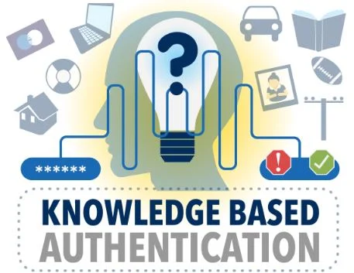
Authentication by Knowledge –
When the user offers a secret that only they know, that is known-only authentication by knowledge. A password, PIN code, or security question provided by the user would be examples of knowledge-based authentication.

Slide 8
Authorization – When a user has successfully established their identity, pre-determined permissions are granted to them during the authorization stage. The level of clearance that should be provided is determined by the reference monitor or authorization matrix, which also stores and transmits control information.
Default access privileges will be set to default deny (deny all).
Access to information and information systems must be limited to personnel and processes with a need-to-know to effectively fulfill their duties.
Access permissions must be based on the minimum required to perform the
job or program function.
4. Information and information system owners are responsible for determining access rights and permissions.
5. The Office of Information Security is responsible for enforcing an authorization process.
6. Permissions must not be granted until the authorization process is complete.

Slide 9

Authentication by Ownership or Possession –
With this type of authentication, the user is asked to provide proof that he owns something specific—for example, a system might require an employee to use a badge to access a facility. Another example of authentication by ownership is the use of a token or smart card.
Possession – The most common of the four is the one-time passcode sent to a device in the user’s possession.

Slide 10
Authentication by Characteristic –
Authentication by characteristic, often known as a biometric attribute, authentication verifies the user based on a physical or behavioral characteristic. The following physical or physiological traits are the most prevalent:
1. Fingerprint
2. Face recognition
3. Retina and iris
4. Palm and hand geometry
5. Blood and vascular information
6. Voice recognition

Slide 11
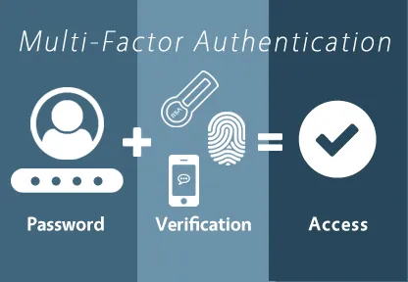
Multi-Factor Authentication – When only one factor is provided, it is known as single-factor authentication. The password is the single-factor authentication technique that is used the most. When two or more factors are presented, it is considered multifactor authentication. When two or more of the same kind of factors are presented, this is known as multilayer authentication.

Slide 12
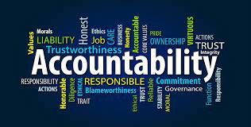
Accountability or Audit – Accountability or audit are the last two components of the access control system. Your system can offer logs at this point so that use and permissions can be audited. By doing this, you can track what happened if something goes wrong, including what data was accessed or downloaded and how long each task took.
An authorization policy should implement two concepts:
Implicit deny: If no rule is specified for the transaction of the subject/object, the authorization policy should deny the transaction.
2. Need-to-know: A subject should be granted access to an object only if the access is needed to carry out the job of the subject.

Slide 13
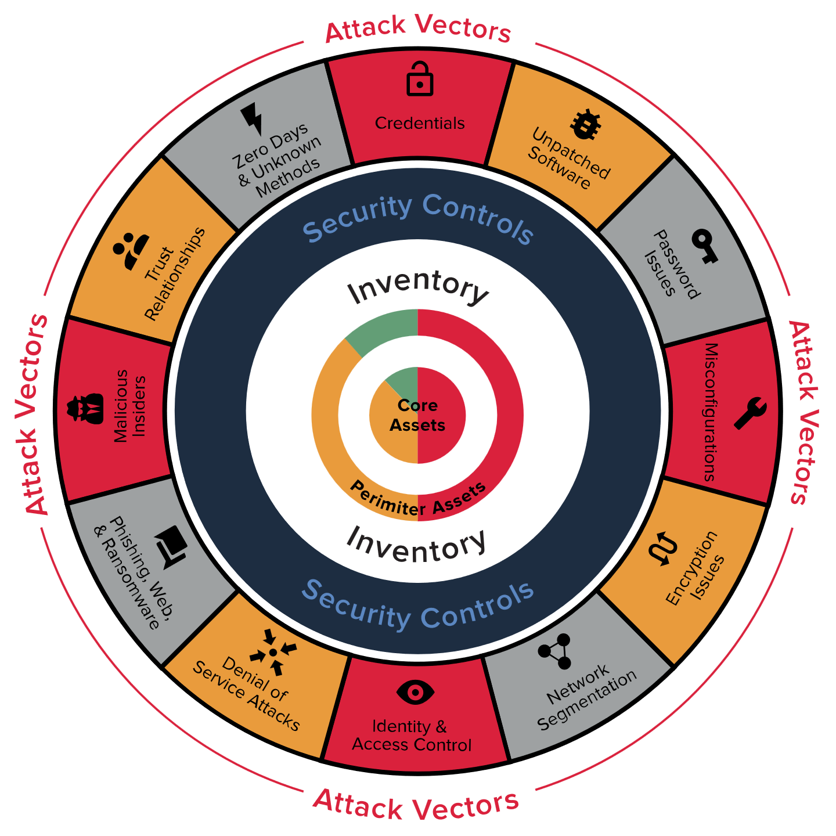
What Is a Security Posture?
A security posture is an organization’s approach to access controls based on information about an object, such as a host (end system) or network.

Slide 14
There is a concept called network access control (NAC) in which networking devices such as switches, firewalls, wireless access points, and others can enforce policy based on the security posture of a subject, in this case, a device trying to join the network.
NAC can provide the following:
Identity and trust
Visibility
Correlation
Instrumentation and management
Isolation and segmentation
Policy Enforcement
Open and secure are the two primary stances. Open, often known as default allow, denotes that access that isn't expressly prohibited is allowed. Secure, also known as default deny, denotes that any access that is not explicitly permitted is prohibited. In actual usage, default deny indicates that access is blocked until a rule, access control list (ACL), or setting is changed to permit access.

Slide 15

Principle of Least Privilege and Separation of Duties –
The principle of least privilege states that all users—whether they are individual contributors, managers, directors, or executives—should be granted only the level of privilege they need to do their jobs, and no more.
The software can benefit from the same idea of least privilege. For instance, applications or processes running on a system should only have access to the resources necessary to complete their tasks. They shouldn't have root access.

Slide 16
Infrastructure Access Control
What is infrastructure network?
What is Infrastructure Access control?
What types of controls are included?

Slide 17
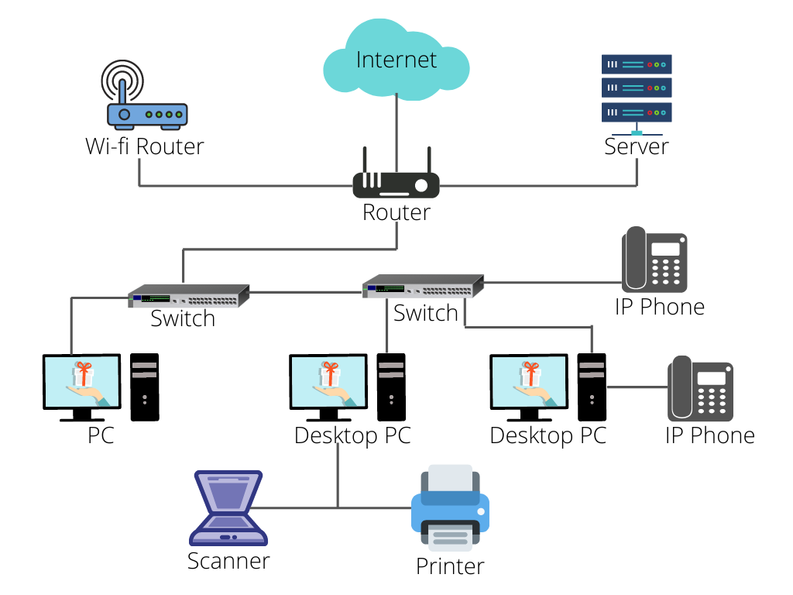

Slide 18
Why Segment a network?
What is Network classification?
The ability to implement different services, authentication requirements, and security measures is made possible through segmentation.

Slide 19
Types of Segmented Network
Enclave network
Trusted Network (Wired/Wireless)
Semi Trusted Network
Guest Network
Untrusted Network

Slide 20
Technologies used to segment a Network
Virtual LANs (VLANs)
Security Group Tagging (SGT)
VPN Routing and Forwarding (VRF)
vMicro-segmentation at the virtual machine level
Micro-segmentation for containers

Slide 21
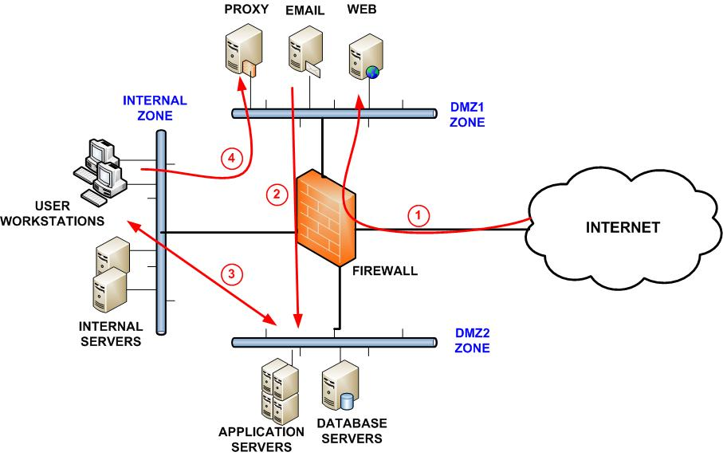
Layered border security
What is layer security?
What is layered border security?
It includes controls like firewalls,

Slide 22
Firewalls
What is firewall?
Firewalls are handled and configured with procedures and rule sets to control incoming and outgoing traffic.
Without it, network is completely exposed and can be compromised.

Slide 23
The process used to allow or block traffic includes:
Simple packet filtering techniques
Application Proxies
Network Address Protocol
Stateful inspection firewalls
Next-gen context-aware firewalls

Slide 24
Intrusion Detection and Prevention
When malicious activities masquerade legitimate traffic these are used.
IDS is a passive to analyze traffic to detect unauthorized access, and stressful protocol analysis and if it detects anything IDS generates an email, message or text alert.
IPS is an active device which seats in line with traffic and responds to identify threads by disabling connection, dropping packets or deleting malicious content.

Slide 25
Technologies used by IDS/IPS
Network-based: Monitors network traffic for a specific segment, and device and analyze activities.
Wireless IDS/IPS: Monitors wireless network traffic and analyzes activities and protocols.
Network behavioral analysis: It examines the traffic to identify threats, information flow, DDOS, malware and policy violations.
Host-based IDS/IPS: It monitors every single host and its events.

Slide 26
Decision States
True positive: It correctly identifies an issue.
True Negative: It correctly identifies normal traffic.
False Positive: Incorrectly identifies normal activity as an issue
False Negative: Incorrectly identifies an issue as normal activity.

Slide 27
Methodologies used by IDS/ISP for detection:
Pattern matching and stateful pattern matching recognition
Protocol analysis
Heuristic-based analysis
Anomaly-based analysis
Correlation protection capabilities based on threat intelligence

Slide 28
Content filtering & whitelisting/Backlisting
Content Filtering: Allow or restrict access based on its content.
Whitelist: Specific sites have access
Blacklist: Where access is denied
It commonly blocks the entire range of IPS specific to geographic locations
Restrict the access by content categories.

Slide 29
Border device administration and management
Everything has to be monitored- Logs and alerts must be monitored and analyzed (successful and unsuccessful both)
Policies need to be updated as per requirements.
Detail examination of all changes since the last review.
External pen testing used to verify the device performance.

Slide 30
Types of Security groups
Blue teams: Defenders of the corporate network which includes SOC, CSIRTS, Infosec teams
Red Teams: Ethical hackers, Pen testers who identify vulnerabilities, attack detection and response capability of the device.
Purple Team: When Red and Blue teams aligned forces to completely defend the organization.

Slide 31
Remote access security
It has controls like authentication, that must be chosen carefully based on network-segmented information and classification that is accessible.
It follows CIA triads:
Restricted information can’t be accessible to unauthorized parties, detecting good and bad modifications and ensuring the user can access required resources,
It must include physical control of client devices.

Slide 32
Remote access technologies
VPN: Secure tunnel for transmitting data through the internet.
Achieved through tunnelling and encryption. To provide high security without the high cost of private lines. It is connected between physical or remote sites.

Slide 33
Remote access authentication and authorization
Implement mutual authentication so they can verify legitimacy before providing authentication credentials.
MFA is required for access
Additionally user should require authentication periodically in remote access devices, they should ensure if they made the base line required for internal systems.

Slide 34
Network access control
Used to check remote access device based on its criteria, if it doesn’t meet a specific criteria access is denied.

Slide 35

Teleworking access control
Allows users to work offsite. Often from home or other locations.
Access company recourses by VPN
Equipment's should be provided by company to have proper access control
Special Access policy and standards will be in action

Slide 36
Teleworking Benefits
Reduction in vehicle pollution
Improved work-life balance
Reduced dependency on imported oils
New opportunities
Establishment of distributed workflows

Slide 37

User Access Control
Business can’t run without users
Clients or Customers
Employees
HR
IT
Marketing
Managers
Owners
Board Members

Slide 38
What is User Access Control?
Ensure that a user can ACCESS only SPECIFIC INFORMATION or SPECIFIC CONTROL in an organization or company.
Controls such as –
System administrators can only access to the active directories, CRUD a users etc.
HR Team controls employee information

Slide 39
Why User Access Control?
Humans are naturally curious
If we don’t set user controls, Information confidentiality and Integrity will be in danger.
To protect data and information User Access controls are used

Slide 40
How to implement User Access Control?
Identifying account types (individual, group, system, application, guest, and temporary)
Establishing conditions for group membership Identifying authorized users of the information system and specifying access privileges
Requiring appropriate approvals for requests to establish accounts
Establishing, activating, modifying, disabling, and removing accounts
Specifically authorizing and monitoring the use of guest/anonymous and temporary accounts
Granting access to the system based on A valid access authorization

Slide 41
Least Privilege or Zero Trust
Trust no one. Both inside and outside of the network.
Grant minimum access to data, tools and information
Follows the rule Default deny

Slide 42
Access Controls in AWS, AZURE and operating systems
AWS uses Identity management
Azure uses RBAC (Role based access control)
Operating systems such as Linux uses Users and Groups and gives specific permissions (Read, Write, Execute) for managing access control.

Slide 43
User Access common policies
Default user access permissions will be set to default deny
Access to company information and systems will be authorized only for workforce personnel
Access will be restricted to the minimal amount required to carry out the business requirement of the access.
An authorization process must be maintained.

Slide 44
Privileged controls
Accounts with elevated capabilities beyond regular users.
Network Administrators,
System Administrators,
Database Administrators,
Firewall administrators

Slide 45
Major note on privileged access
Administrative accounts should be accessed only when the activity being performed requires elevated rights and permissions.
No need to use for basic routine activities such as –
Checking email
Surfing internet
If someone logs in as a administrator and the computer is infected with malicious code, then the master of the malware can have root access.
Every user should have a second account with non privileged access

Slide 46
Separation of Duties
Concentration of Power in one hand can be dangerous
Tasks be assigned to individuals in such a manner that no one individual can control a process from start to finish.
Requires 2 or more-person permission to complete a task

Slide 47
Dual Control
Requires that two individuals must both complete their half of a specific task.
2 separate keys to unlock a door. Each user will be provided a separate key.
1 person can modify the firewall configuration file and the other person can push it to production

Slide 48
Benefits of Dual Control
How can it help us?
An insider threat can’t execute a malicious activity alone
Reducing and preventing irregularities
one person is not responsible for everything

Slide 49
Monitoring User activities and accesses
Company gathers data from–
Network traffic
DLP
Firewalls
MONITORING
Access logs must be reviewed daily by the Office of Information Technology or designee.

Slide 50
Monitoring Benefits
Detect unauthorized access, malware and data leakage
Detect activity with privileged access, user management, policy changes, remote desktop sessions, configuration changes, and unexpected access
Detect patch installation, software installation, service management, system reboots, bandwidth utilization, and DNS/DHCP traffic

Slide 51
What should be always monitored
Successful Access
Failed Access
Privileged Operations
Exceptions can be addressed by the COO

Slide 52
Is Monitoring Legal?
An employee can be monitored by the company
The work is done at the employer’s place of business.
The employer owns the equipment.
The employer has an interest in monitoring employee activity to ensure the quality of work.
The employer has the right to protect property from theft and fraud.
SLA and Agreements are signed with the employee to monitor their activities

Slide 53
QA?

